Slide 1
Lesson 3.11
Roles and Responsibilities
CGPRT(W) : Ensuring Clean Seas and Coasts in Western Region ……

Slide 2
Objective
To understand the roles and responsibilities of all parties that may be involved in the incident response.
CGPRT(W) : Ensuring Clean Seas and Coasts in Western Region ……

Slide 3
Introduction
Who are involved in respect of
the ship, the port, the installation?
the salvors, the insurers, the government and the responders?
What are the government’s responsibilities?
Framework and organization
Preparedness
Training and exercises
CGPRT(W) : Ensuring Clean Seas and Coasts in Western Region ……

Slide 4
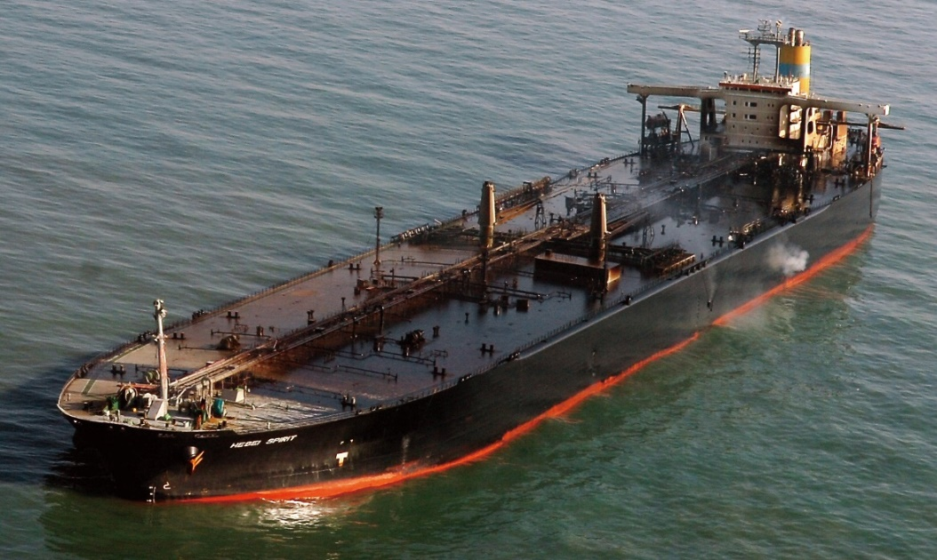
The Ship
Master
Crew
Superintendent
Manager
Owner
Third party technical support
Qualified individual (as appropriate)
Classification society
Flag State
CGPRT(W) : Ensuring Clean Seas and Coasts in Western Region ……

Slide 5
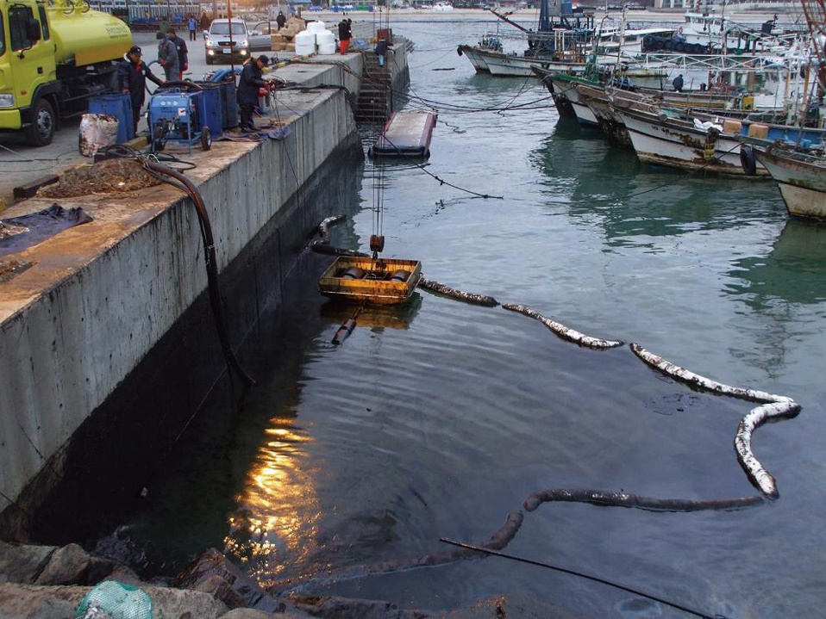
The Port
Port Authority
Harbour Master
Marine staff
Technical support
Administrative support
Pilots
Source: Korea Coast Guard
CGPRT(W) : Ensuring Clean Seas and Coasts in Western Region ……

Slide 6
The Installation
Owner(s)
Operator
Oil Installation Manager (OIM)
Installation crew and contractors
Duty manager
Incident response team
Crisis management team
Business continuity
CGPRT(W) : Ensuring Clean Seas and Coasts in Western Region ……

Slide 7
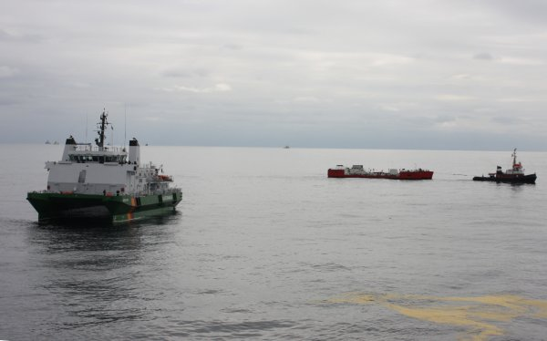
The Salvors
Salvage company
Salvage manager
Salvage master
Technical engineers
Salvage crew and divers
Specialist support
CGPRT(W) : Ensuring Clean Seas and Coasts in Western Region ……

Slide 8
Insurance
Cargo owners
Hull and machinery insurance
Cargo insurance
Protection and Indemnity (P&I) insurance
  local correspondents
International Group (P&I)
Specialist loss adjusters
ITOPF Limited
The IOPC Fund
CGPRT(W) : Ensuring Clean Seas and Coasts in Western Region ……

Slide 9
The Government − Regulator
Cabinet of ministers (or appropriate body)
Regulator – shipping, ports, offshore
Port State control
Immigration
Customs
Relationship with neighbours and region
Foreign embassies
International community
CGPRT(W) : Ensuring Clean Seas and Coasts in Western Region ……

Slide 10
The Government – Response
National Competent Authority
Military − navy, air force, army, civil defence, coastguard
Air traffic control
NCP stakeholders
Responders
Industry
Bilateral or regional partners
CGPRT(W) : Ensuring Clean Seas and Coasts in Western Region ……

Slide 11
Industry Response
The extent of industry’s involvement in the response will be driven by the government’s response philosophy.
If the government takes the lead, the role of industry may be restricted to:
their personnel
their assets
technical expertise
logistical support
CGPRT(W) : Ensuring Clean Seas and Coasts in Western Region ……

Slide 12
Framework for Response
National contingency plan should define:
Legal framework
  International/regional/bilateral obligations
  National laws
Organizational structure
Responsibility for the response: government or spiller?
CGPRT(W) : Ensuring Clean Seas and Coasts in Western Region ……

Slide 13
Framework for Response
Competent national authority(ies) with responsibility for preparedness and response:
  at sea – ships, installations?
  on shore?
  oil and HNS or only oil?
Operational contact point
  receipt/transmission of pollution reports
Authority to request/render assistance
CGPRT(W) : Ensuring Clean Seas and Coasts in Western Region ……

Slide 14
Government Responsibilities
Organizational arrangements
Planning requirements
Monitoring and reporting
Defined operational procedures
Training and exercising
Financial and liability arrangements
CGPRT(W) : Ensuring Clean Seas and Coasts in Western Region ……

Slide 15
Organizational Arrangements
Essential that roles, responsibilities and capabilities of the various parties be identified
Establish clearly who has the onus of response
Consideration given to many tasks
  prevention
  preparedness
  response
  recovery/remediation
CGPRT(W) : Ensuring Clean Seas and Coasts in Western Region ……

Slide 16
Prevention
Activities directed towards preventing or reducing the impact of incidents
evaluate existing polices, etc.
identify any gaps
prepare relevant policies and legislative elements
establish mandatory compliance requirements
CGPRT(W) : Ensuring Clean Seas and Coasts in Western Region ……

Slide 17
Preparedness
Activities meant to enhance the ability to respond to emergencies
development of emergency response plans
ensuring the availability of response resources and equipment
training and exercising of personnel
establishment of communication and alert channels
CGPRT(W) : Ensuring Clean Seas and Coasts in Western Region ……

Slide 18
Preparedness
Preparedness should take into account
differing scenarios to probable incidents
organizations and activities involved
joint planning and training of those who may need to work together
close collaboration required between different parties from differing backgrounds
CGPRT(W) : Ensuring Clean Seas and Coasts in Western Region ……

Slide 19
Preparedness
Administrations should provide
plans
expert assistance
operational centre(s)
incident monitoring
incident coordination
CGPRT(W) : Ensuring Clean Seas and Coasts in Western Region ……

Slide 20
Preparedness
Specific issues of concern should include:
preparing relevant guidelines and policies
defining reporting procedures
preparing and implementing periodic inspection and auditing protocols
collecting and disseminating information
defining emergency response planning requirements
establishing information databases
CGPRT(W) : Ensuring Clean Seas and Coasts in Western Region ……

Slide 21
Preparedness
Specific issues of concern should include:
identifying expertise
if numbers are a problem, considering creating a “pool of experts” to act as an advisory group
identifying resources
training resources
exercising resources
facilitation of transboundary response (people and equipment)
CGPRT(W) : Ensuring Clean Seas and Coasts in Western Region ……

Slide 22
Monitoring and Reporting
Establishment of reporting procedures
who is responsible for reporting?
to whom should reports be made?
what format should be used?
when are reports to be made
Linked to appropriate record-keeping process
CGPRT(W) : Ensuring Clean Seas and Coasts in Western Region ……

Slide 23
Defined Operational Procedures
To ensure an appropriate and effective response in a timely fashion
Develop clearly defined operational procedures
Consider possible scenarios
Integrate different response resources
Incorporate lessons learned
CGPRT(W) : Ensuring Clean Seas and Coasts in Western Region ……

Slide 24
Training and Exercise
Training standards should be prescribed for all response personnel
specific training content adapted to individual roles and job performance expectations
schedules for implementation and compliance dates
requirements for issuing of training certificates
requirements for periodic training
CGPRT(W) : Ensuring Clean Seas and Coasts in Western Region ……

Slide 25
Training and Exercise
Training standards should be prescribed for all response personnel
requirements for exercises or drills
certification/approval of training delivery organizations
equivalency with international training requirements
CGPRT(W) : Ensuring Clean Seas and Coasts in Western Region ……

Slide 26
Summary
In this lesson we have considered the roles and responsibilities of all parties that may be involved in the incident response.
CGPRT(W) : Ensuring Clean Seas and Coasts in Western Region ……

Slide 27
Any questions?
CGPRT(W) : Ensuring Clean Seas and Coasts in Western Region ……

